Slide 1
Magnetic Forces on charges moving through a magnetic field.

Slide 2
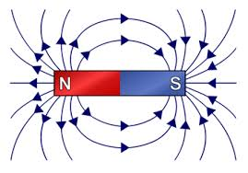
What is the magnetic field?
The magnetic field is a force field just like electric and gravitational fields.
Therefore, it is a vector quantity.
Hence, it has both magnitude and direction.
The symbol for the magnetic field is B.
The unit for magnetic field strength is the tesla (T).
Earth’s magnetic field ranges from $2.5×{10}^{−5} − 6.5×{10}^{−5}T$
The strength of the magnetic field in an MRI is $0.5 −3.0T$

Slide 3
Forces in Magnetism
The existence of magnetic fields is known because of their affects on moving charges.
This force is called the Lorentz Force
Magnitude of the force is proportional to the component of the charge’s velocity that is perpendicular to the magnetic field ($v∙\sin{θ}$).
Direction of the force is also perpendicular to the magnetic field(B).
$$FB=|q|vB sinθ$$

Slide 4
Example #1
A positively charged particle traveling at $7.5×105 m/s$enters a uniform magnetic field perpendicular to the lines of force. While in the $4.0×{10}^{−2} T$magnetic field, a net force of $9.6×{10}^{−2} N$acts on the particle. What is the magnitude of the charge on the particle?
$$q=\frac{F_{B}}{vB}=\frac{9.6×10^{−15}N}{(7.5×10^{5}m/s)(4.0×10^{−2}T)}=3.2×10^{−19}C$$

Slide 5
What does the equation tell us?
$$FB=|q|vB sinθ$$
Because the magnetic force is always perpendicular to the component of the charge’s velocity perpendicular to the magnetic field, it cannot change its speed.
Force is maximum when the charge is moving perpendicular to the magnetic field (θ = 90°).
The force is zero if the charge’s velocity is in the same direction as the magnetic field (θ = 0°).
Lastly, if the speed is constant, then the KE will be constant as well.

Slide 6
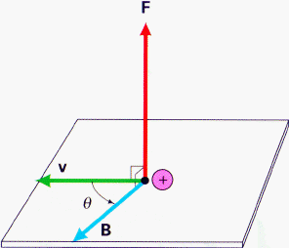
Right Hand Rules
Right hand rule is used to determine the relationship between the magnetic field, the velocity of a positively charged particle and the resulting force it experiences.

Slide 7
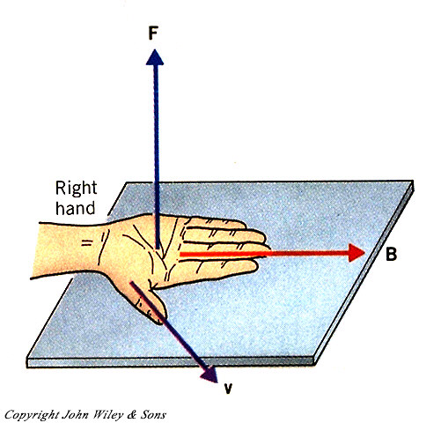
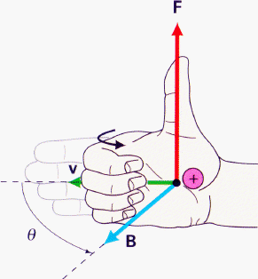
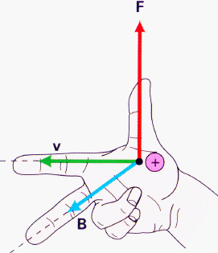
Right Hand Rules
#1
#2
#3
$$FB=|q|v×B$$

Slide 8
Ex.: The Lorentz Force Equation & RHR
F_{B} = qvB sinθ
v•sinθ
V
θ
Uniform B
+
q
What is the direction of the force on the particle by the magnetic field?
Right b. Left c. Up d. Down
Into the page f. Out of the Page
Note: Only the component of velocity perpendicular to the magnetic field ($v∙sin$) will contribute to the force.

Slide 9
Right Hand Rule – What is the Force?
x x x x x x
x x x x x x
x x x x x x
x x x x x x
Direction of magnetic field is into the page
+
v
What is the direction of the magnetic force on the charge?
a) Down b) Up c) Right d)Left

Slide 10
Example 2: Lorentz Force
Two protons are launched into a magnetic field with the same speed as shown. What is the difference in magnitude of the magnetic force on each particle?
a. F₁ < F₂ b. F₁ = F₂ c. F₁ > F₂
x x x x
x x x x
x x x x
+
v₁
$$F=qv×B=qvB∙sinθ$$
Since the angle between B and the particle’s velocity is 90º in both cases, $F1=F2$.
v₂
+
How does the kinetic energy change once the particle is in the B field?
a. Increase b. Decrease c. Stays the Same
Since the magnetic force is always perpendicular to the velocity, it cannot do any work and change its KE.

Slide 11
Key Ideas
Lorentz Force: A charge moving perpendicular to a magnetic field will experience a force.
The force is also perpendicular to the magnetic field.
The magnetic field (B) is a vector quantity with the unit of Tesla
Use right hand rules to determine the relationship between the magnetic field, the velocity of a positively charged particle and the resulting force it experiences.

